Slide 1

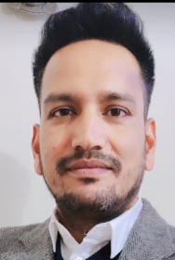
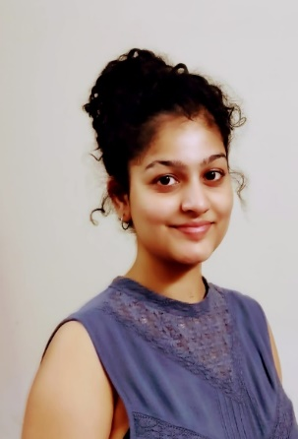
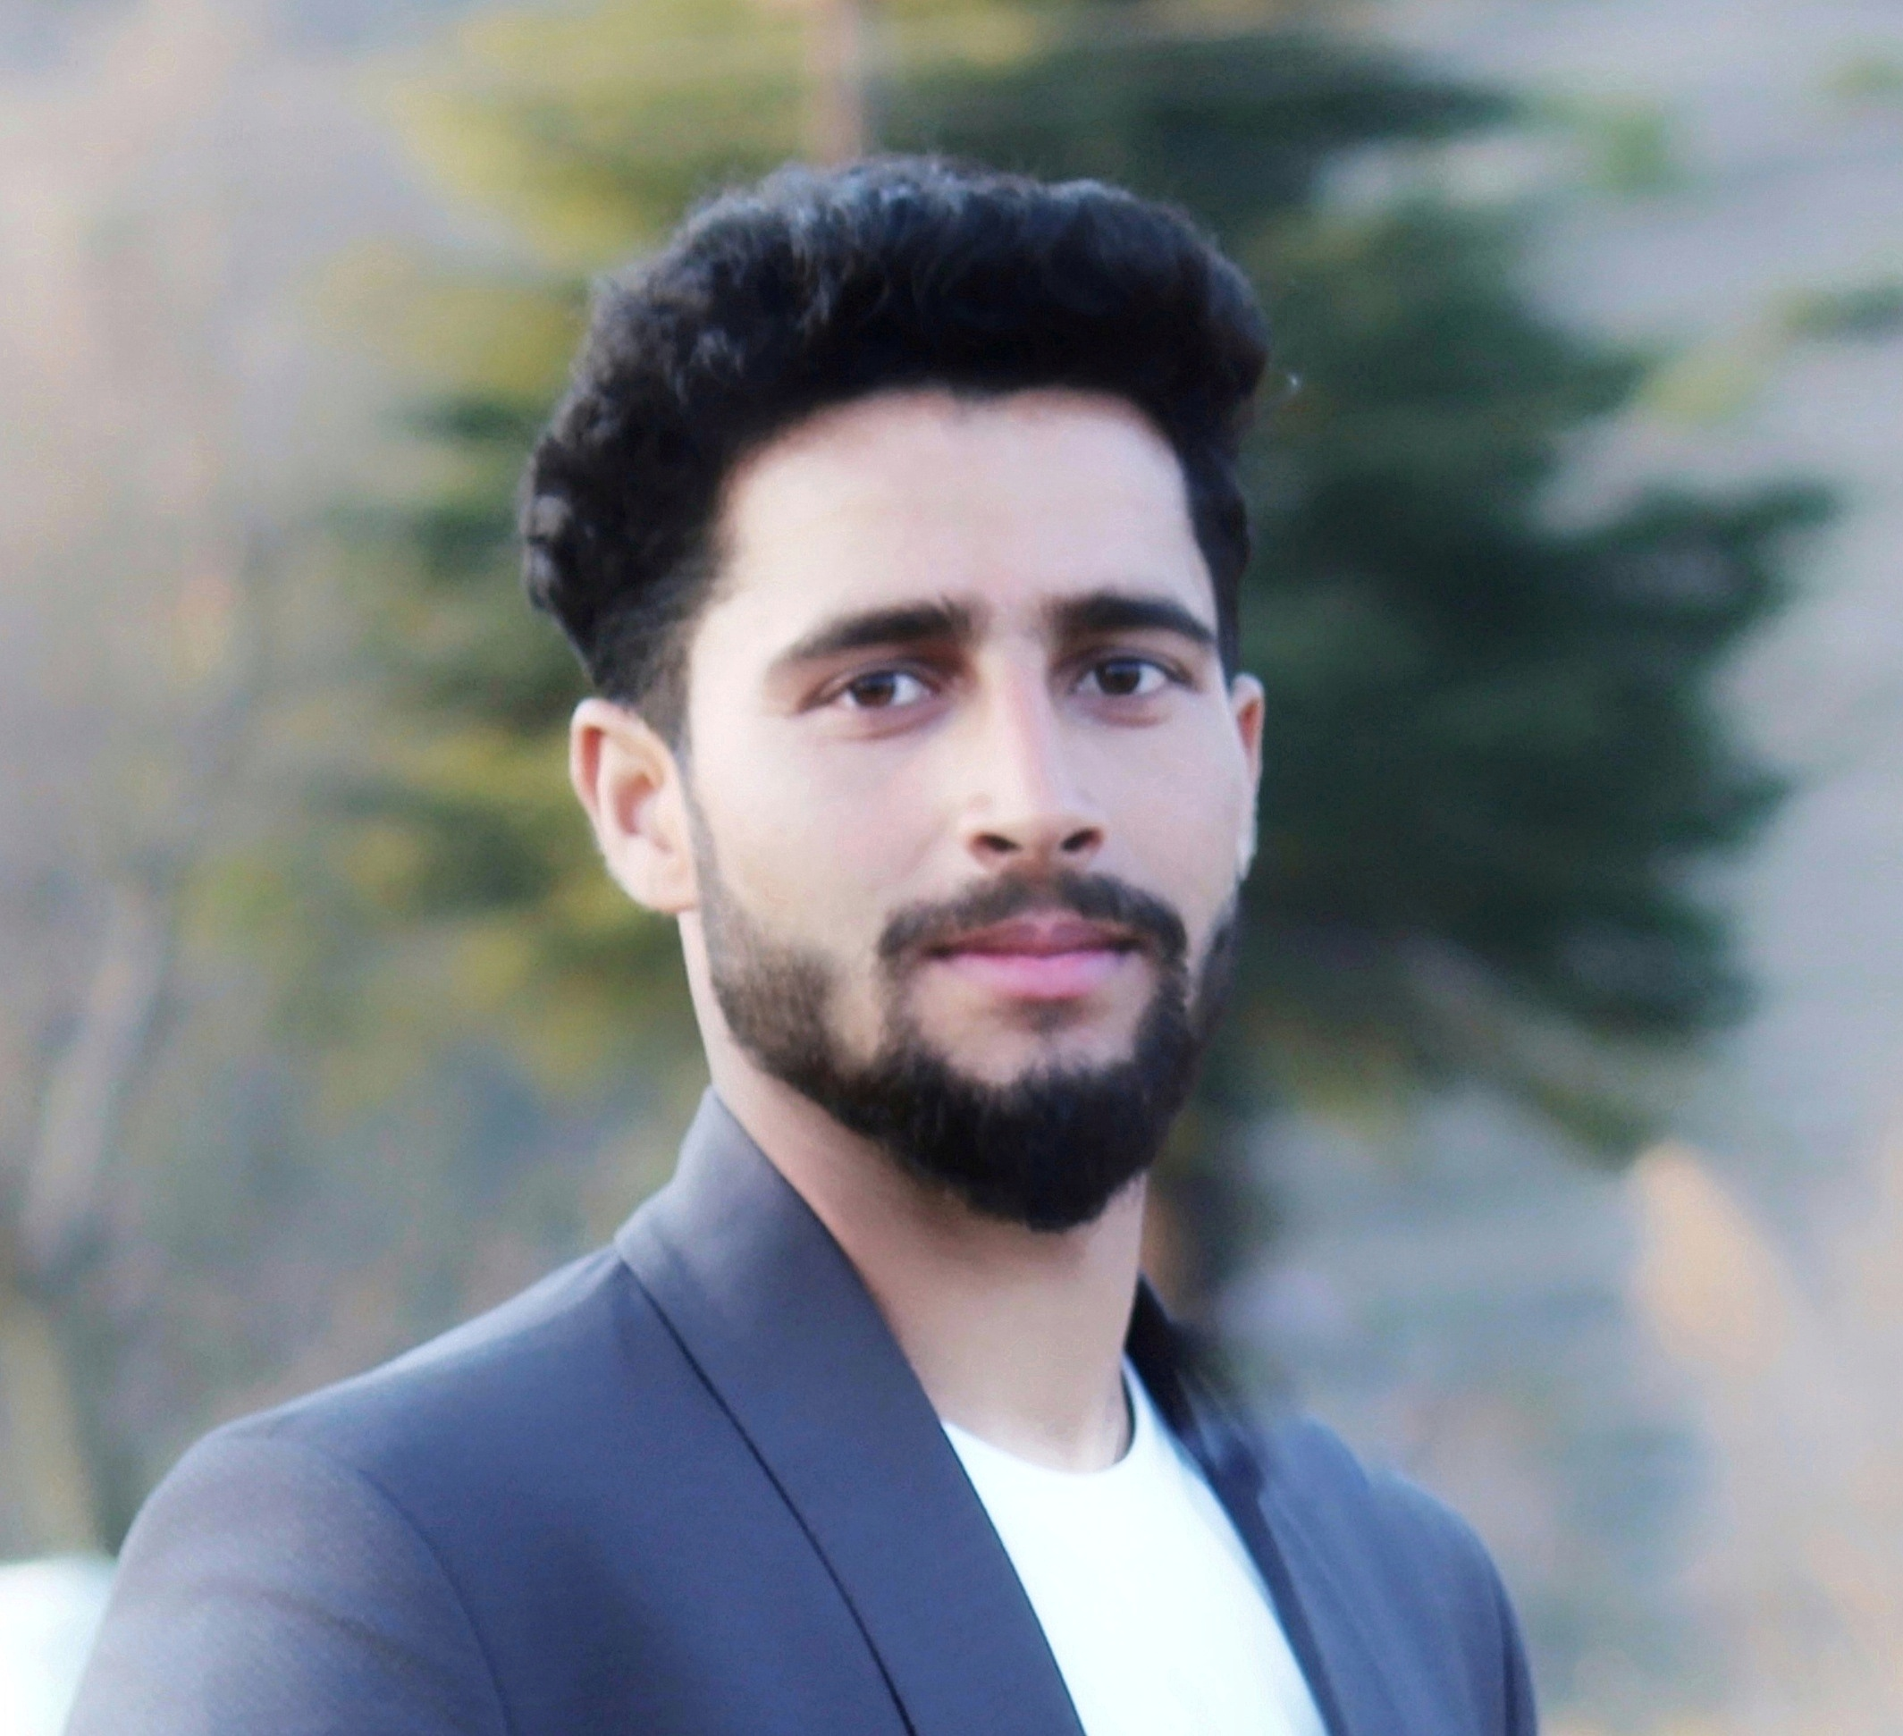
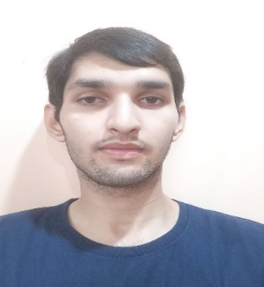
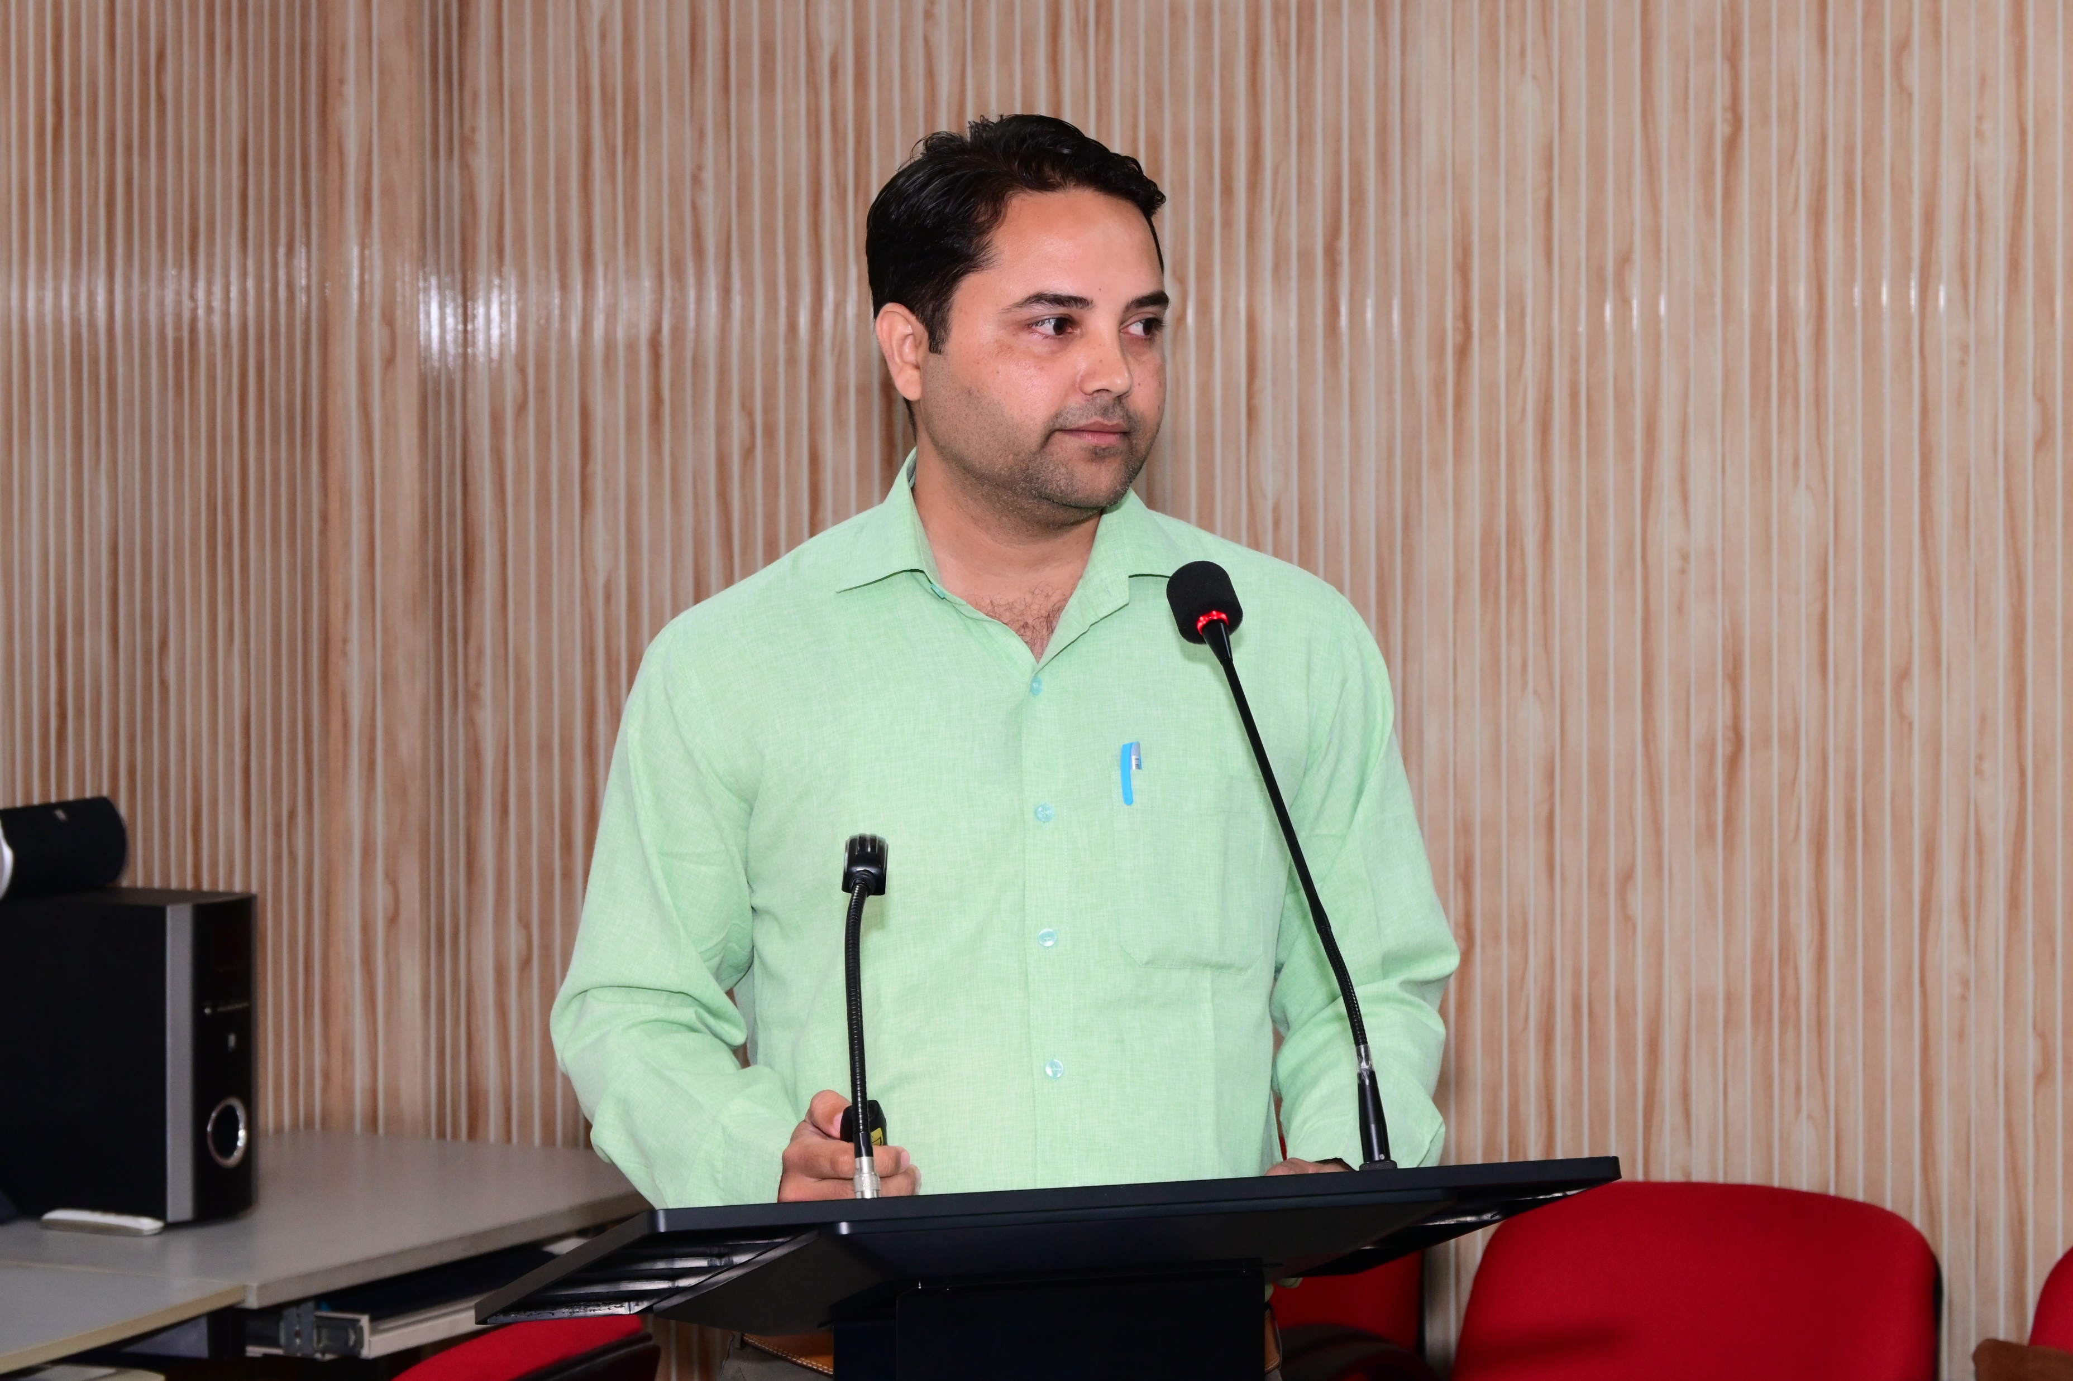
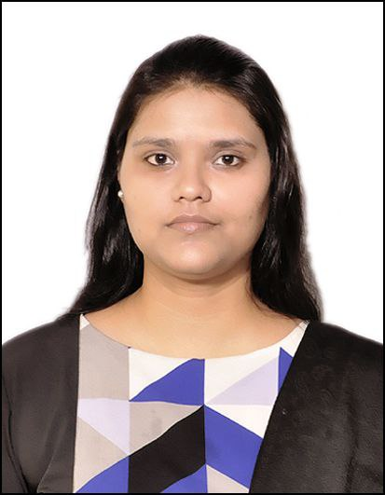
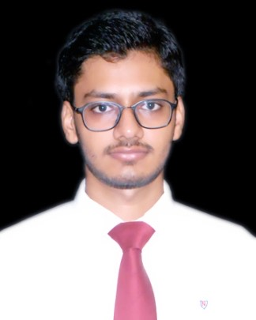
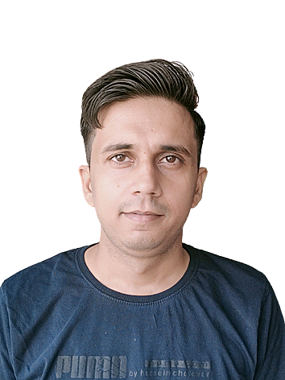
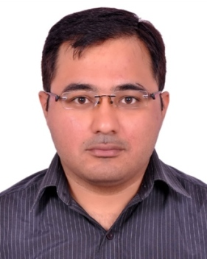
GROUP PROFILE
Dr.Tarun Sharma
(Assistant Professor)
Principal Investigator
Team leader
Modeller, developer
Dr. Arvind Bisht
(Postdoctoral Project Fellow)
Project Coordinator
Modeller
Malvika Bajpai
(Project Associate)
Project Coordinator
Modeller
Ankit Sharma
(Project Associate)
Project Coordinator
Modeller
Kartik Gupta
(Btech 4th year student)
Modeller,
developer
Prashant Giri
Doctoral student
Anu Agarwal
Doctoral student
Ashish Saraswat
Doctoral student
Sandeep Kumar
Doctoral student
Himanshu Badoni
Doctoral student

Slide 2
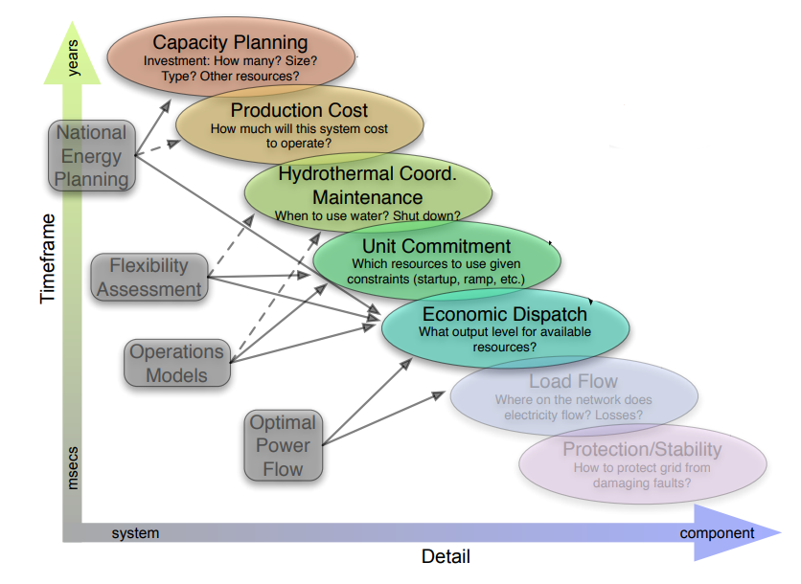
Typology of Energy system modelling
Sharma et al. 2020
Energy system optimization
Sharma et al. 2019
Sharma et al. 2022
Modelling types (Palmintier, 2013)
https://dspace.mit.edu/handle/1721.1/79147

Slide 3
Significance/Pathways to Impact
Developing roadmaps and policies
Identify technology and business opportunities for entrepreneurs and/or existing players in India over the upcoming decades arising from a low carbon energy future.
Assess in detail the value chain for these opportunities in order to determine genuine win-wins for India.
Developing an innovation system to enable delivery of these opportunities.
A platform for integrating models and scenario development.
Unlock the potentials in research and industry.

Slide 4
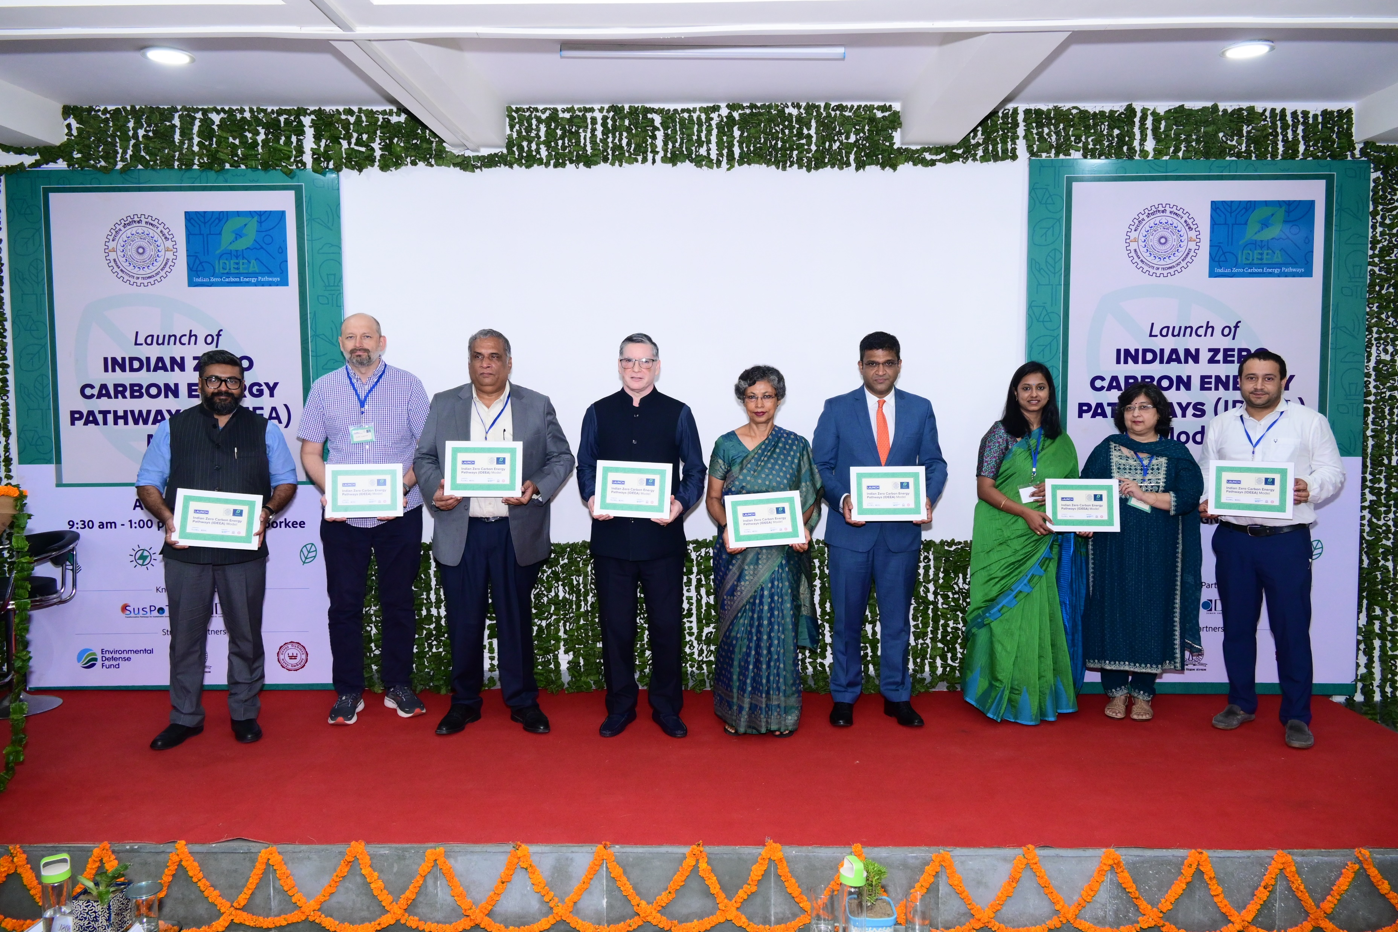
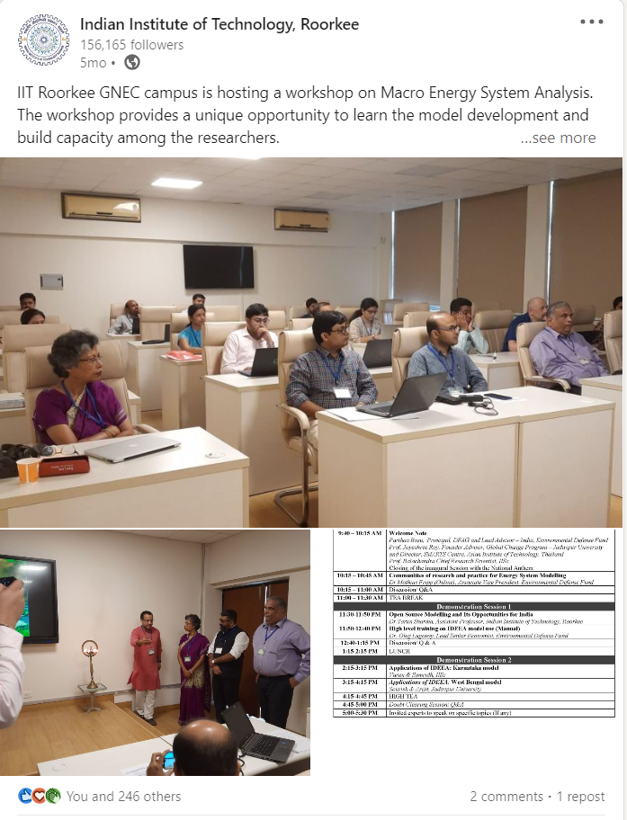
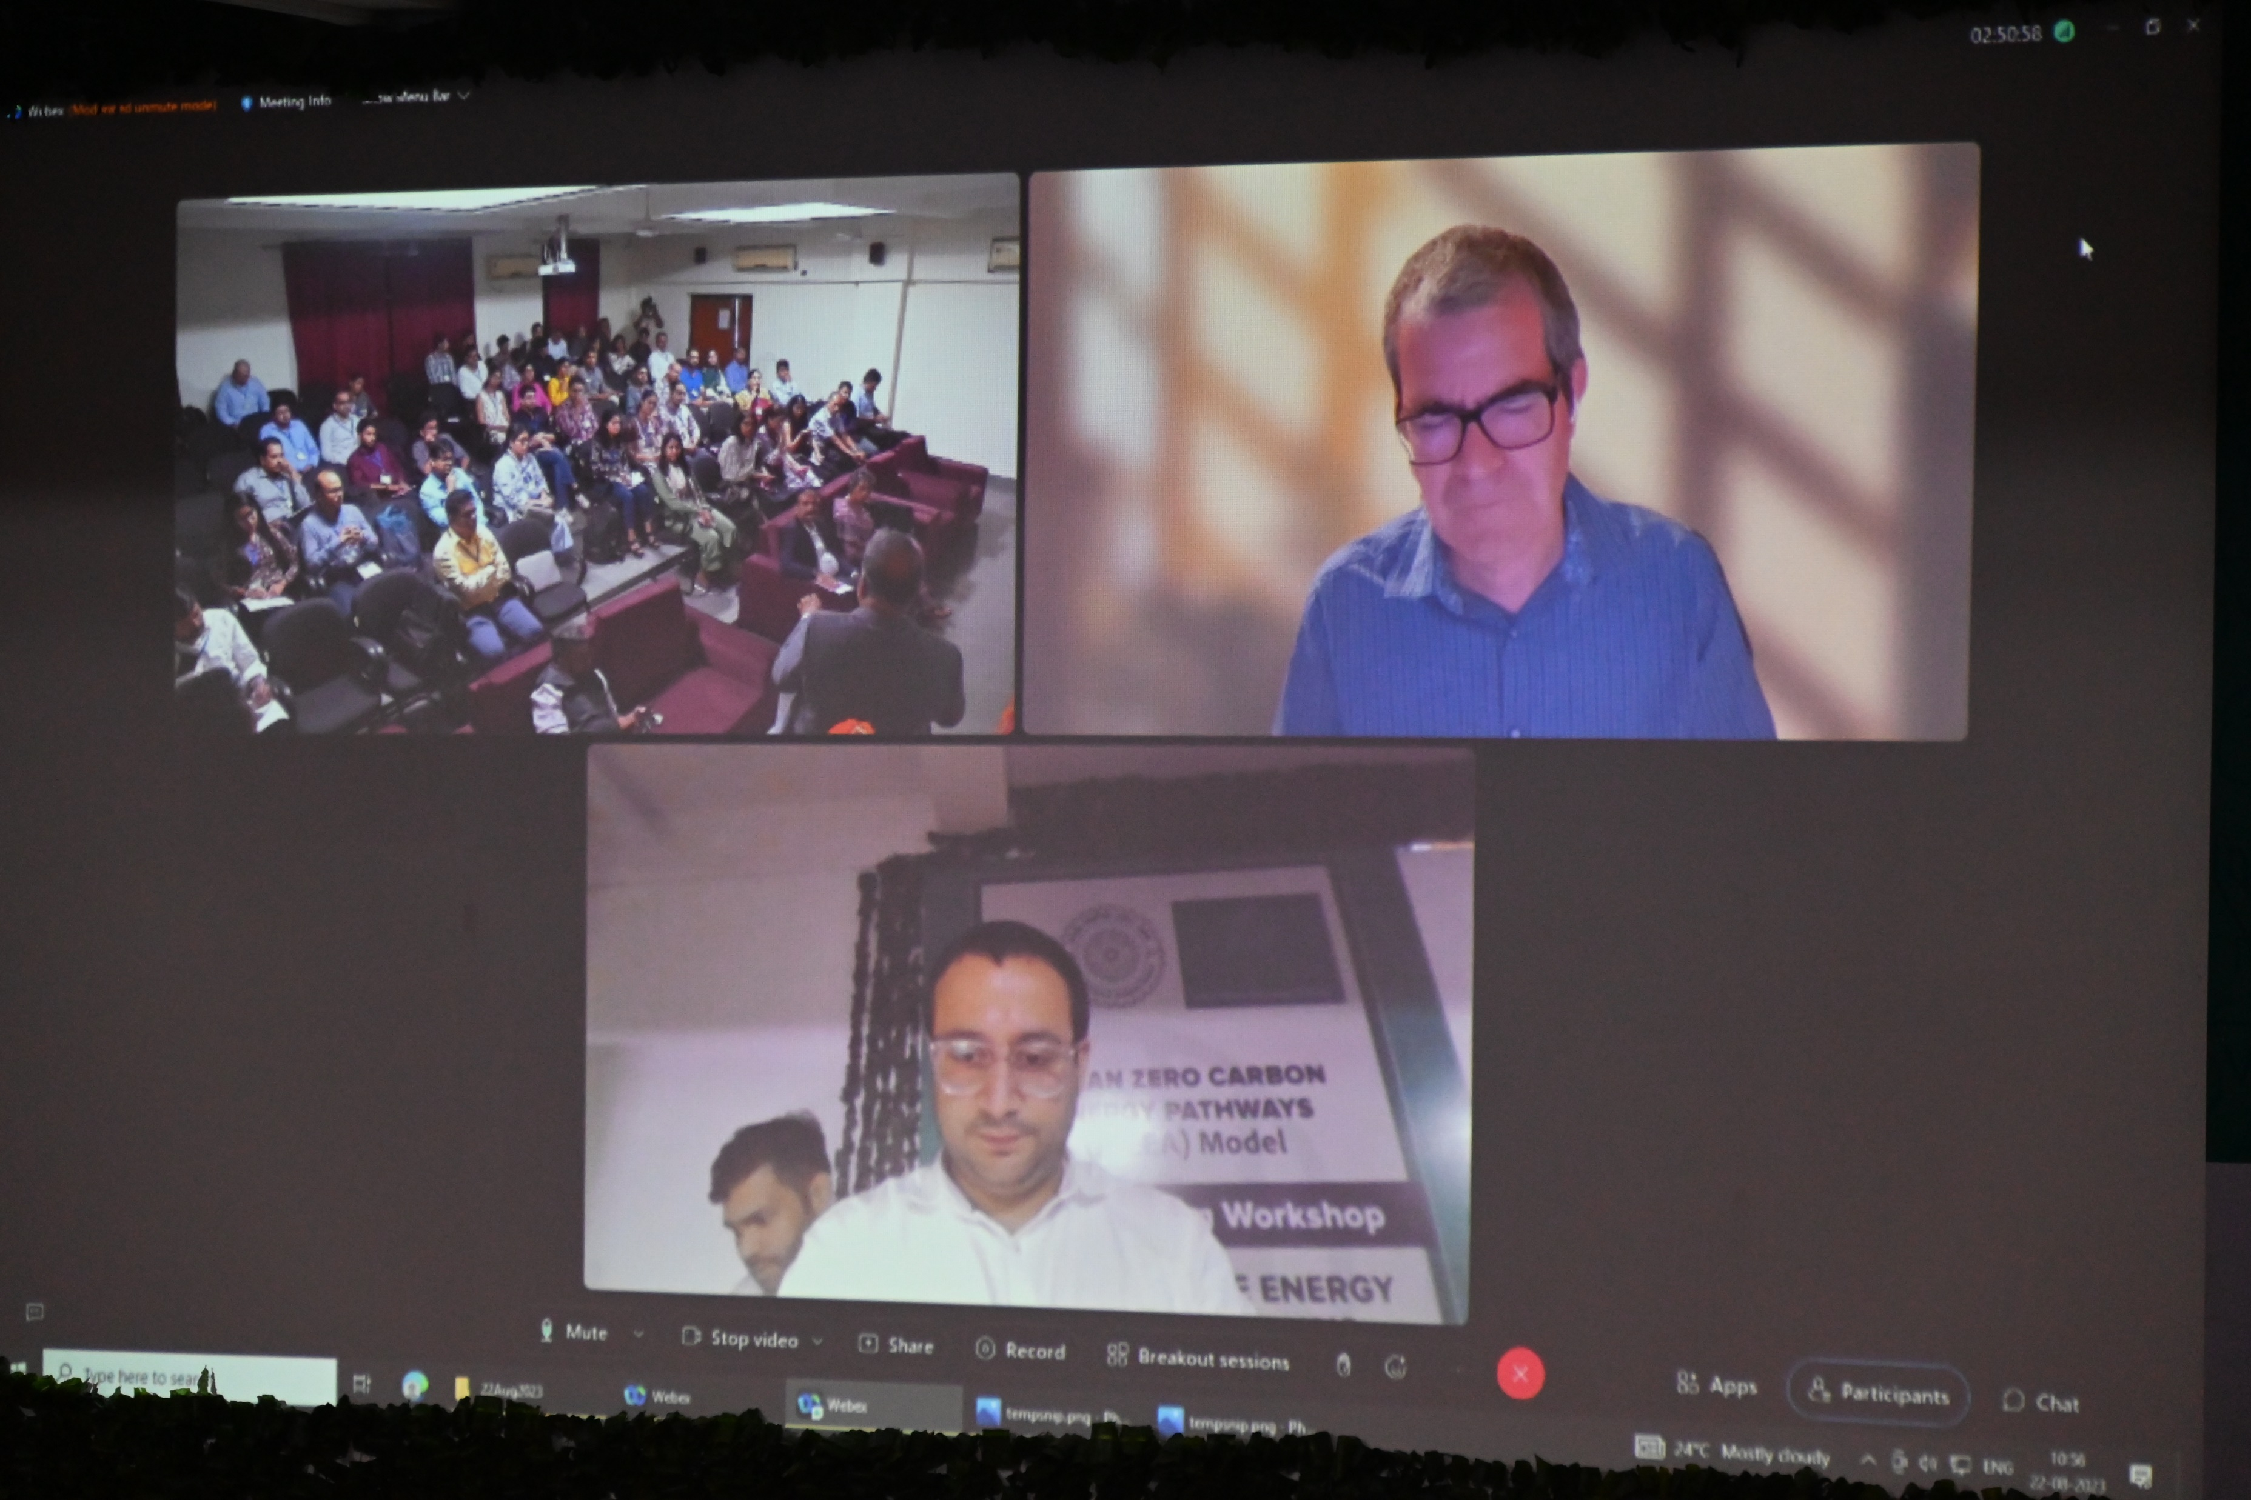
Offsite, Workshop and the IDEEA launch Launch (21-23 Aug, 2023)

Slide 5
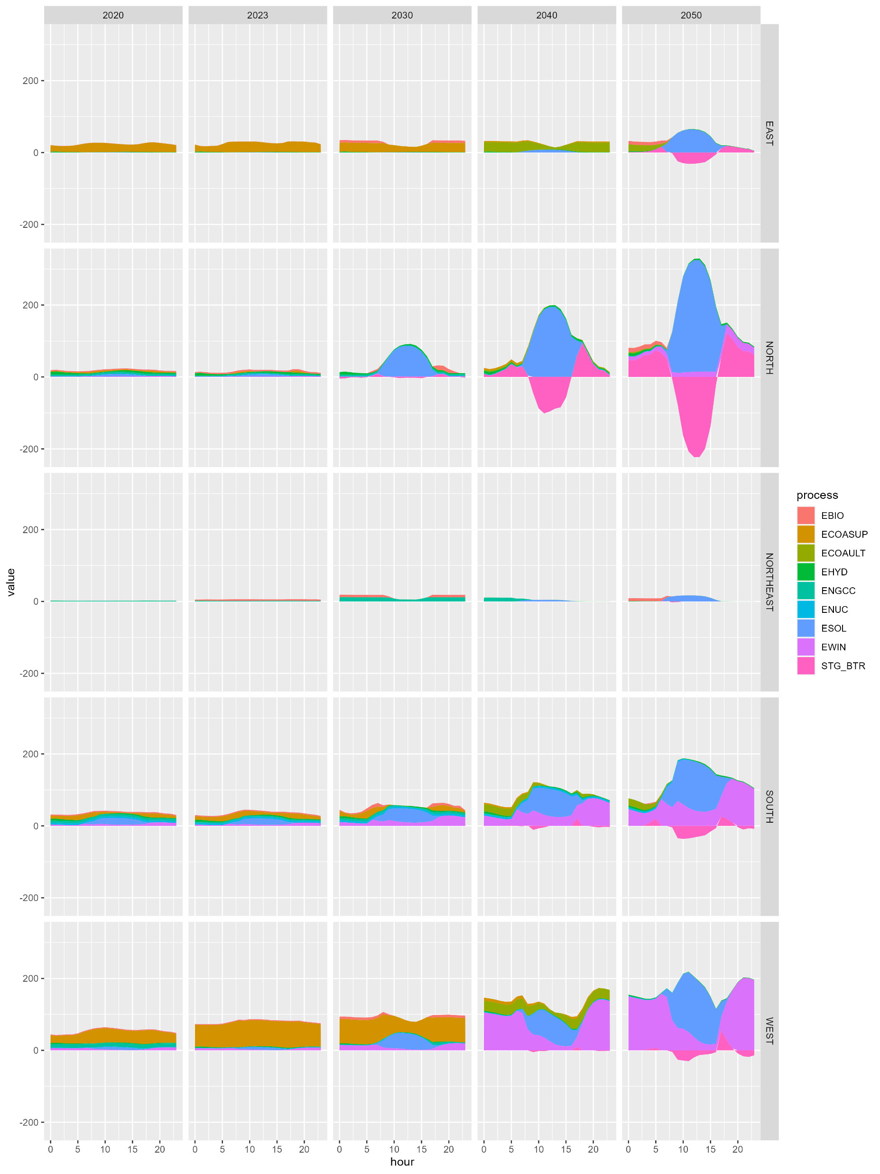
India 2050 Net Zero Electricity System Scenario Snapshot of results

Slide 6
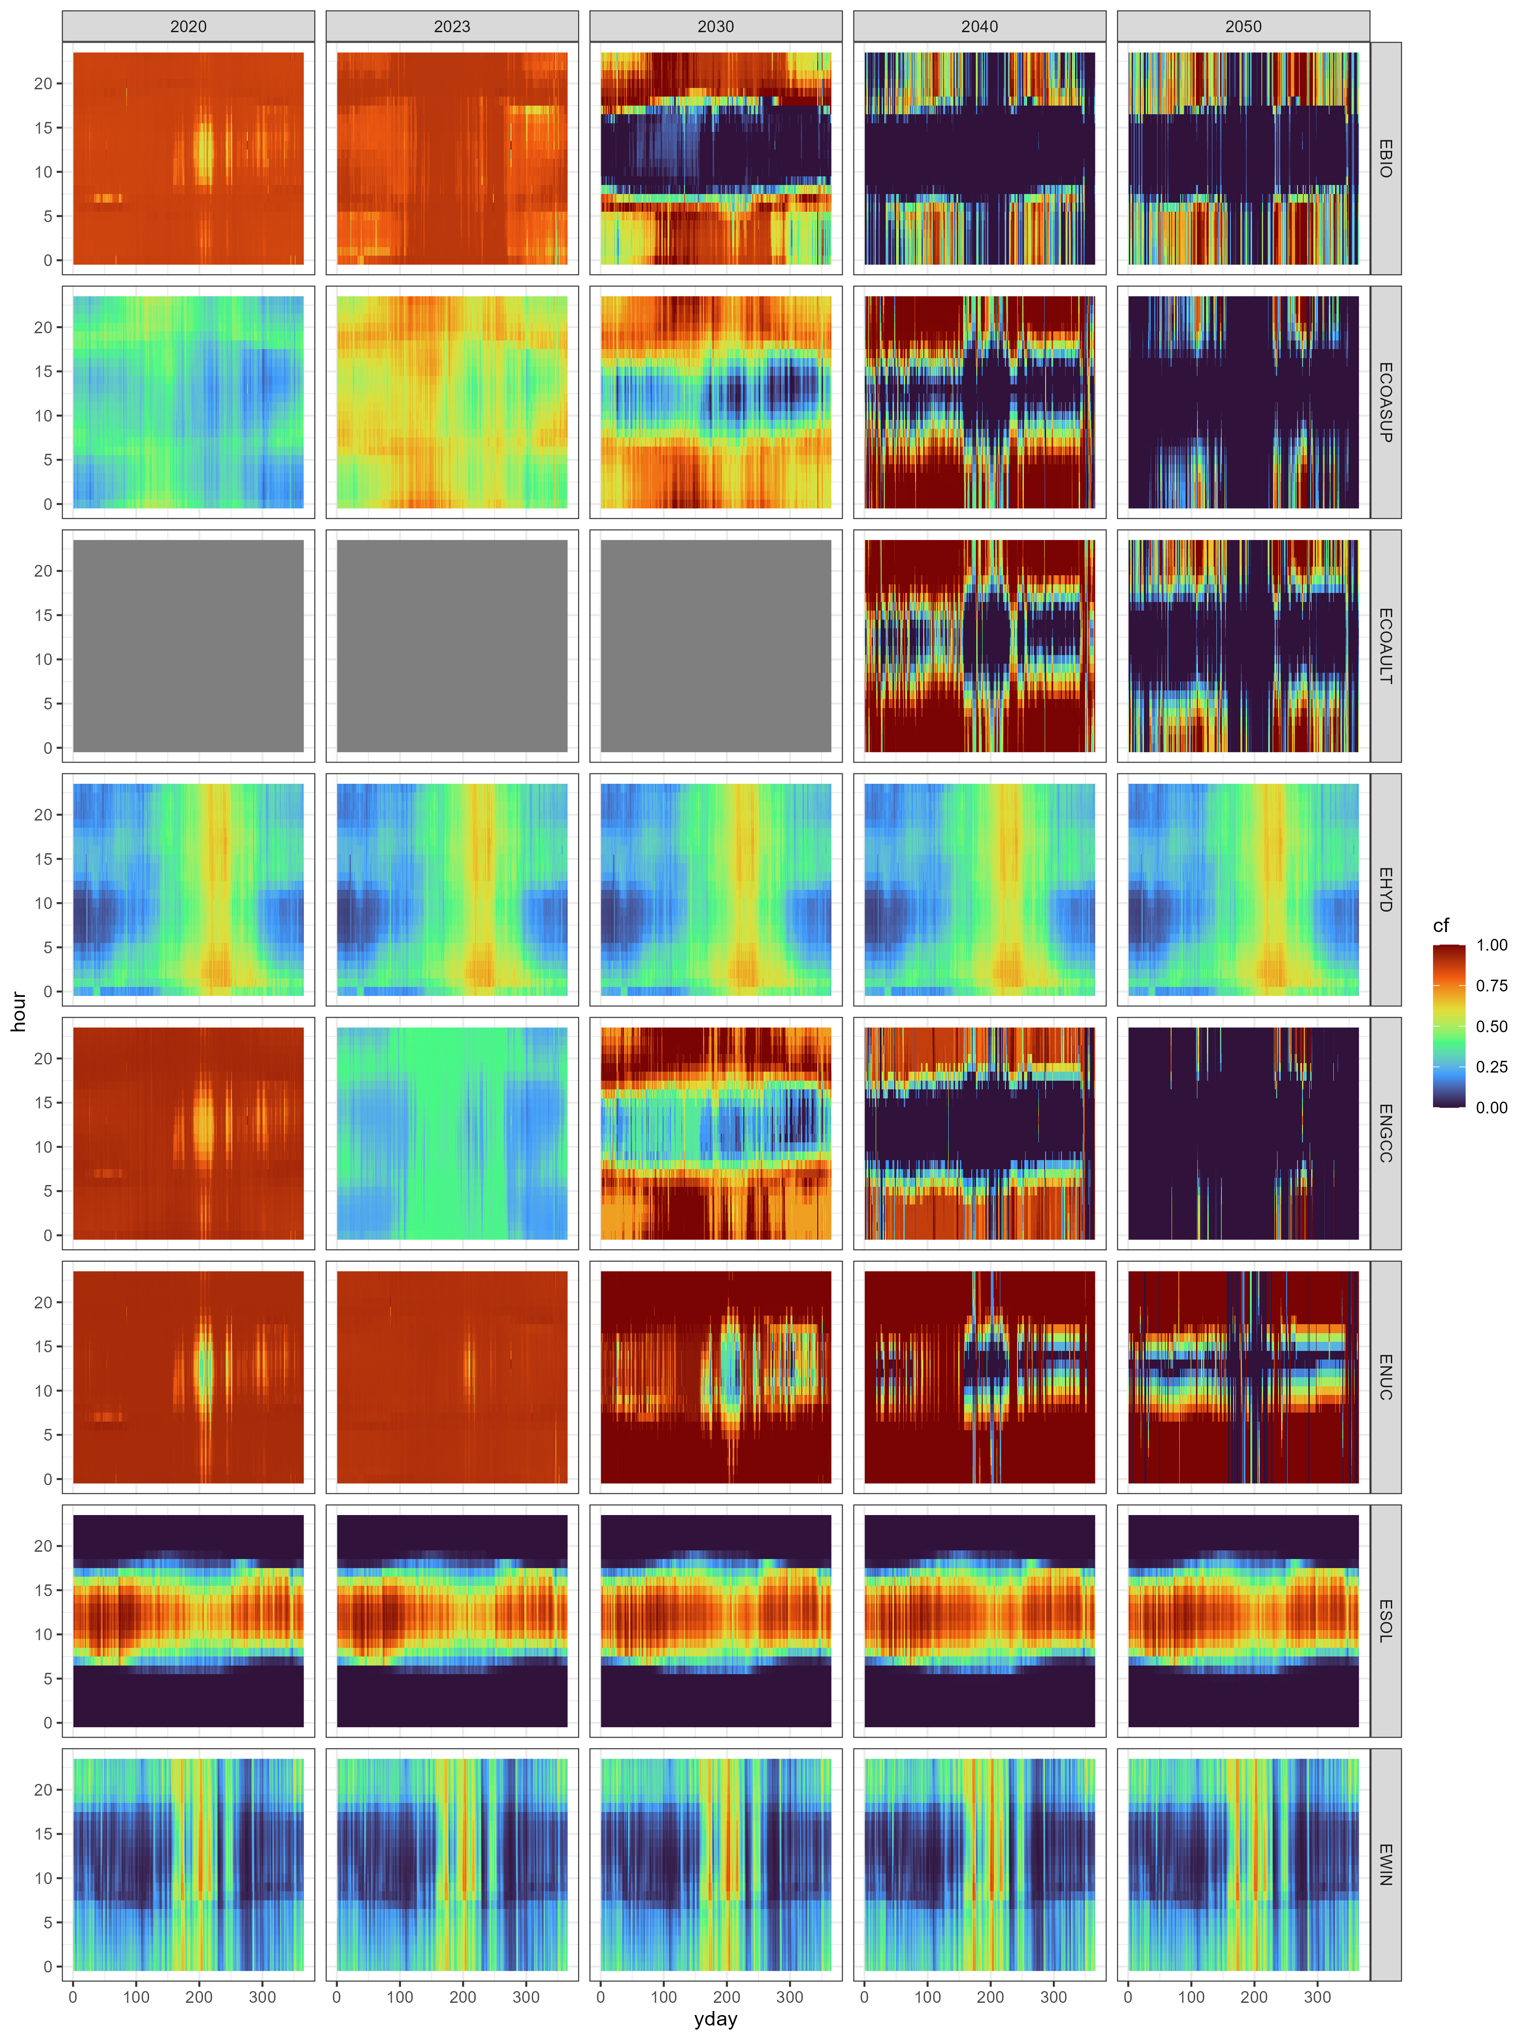
India 2050 Net Zero Electricity System Scenario Snapshot of results

